Slide 1
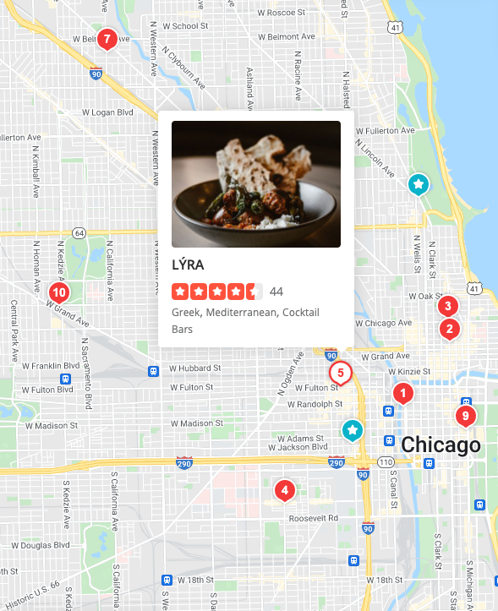

RESTAURANT REVIEWS
Akhir Syabani
Akshat Palnitkar
Ani Baghdasaryan
Sardar Haider Waseem Ilyas
Big Data Platforms
Winter 2022

Slide 2


Outline
1
2
BUSINESS PROBLEMS
Questions/ Use Cases
Data Sources
DATA EXPLORATION
Data Preparation
Exploratory Data Analysis
Visualizations
MODELING & EVALUATION
Recommendation System
Classification
Findings & Insights
PROJECT EXECUTION
Platforms, Tools, Methods
Challenges & Improvements
3
4

Slide 3
Business Problems/ Use Cases
QUESTIONS/ USE CASES
STAKEHOLDERS
ANALYSIS/ MODELING
1
How does Covid-19 affect business?
Public/ General
Timeline Visualization
2
How can we help users find good restaurants?
Users
Location Mapping
YELP
How can we help users get recommendations?
How can business improve their visibility?
How can we increase users’ activity?
Users
Business
Yelp
Recommendation Systems
3
What factors influence higher review stars?
What factors determine useful reviews?
Yelp
Classification 1: Review Stars
Classification 2: Useful Review
4
5
What factors influence higher stars for business?
Business
Classification 3: Business Stars

Slide 4
Data Sources
Sources
Tables
Yelp Open Dataset
https://www.yelp.com/dataset
7 million reviews
150k businesses (~ 50k restaurants)
11 metropolitan locations
Period: 2004-2021
4 json files (total size: ~ 12 GB)
Reviews (7 GB)
Business (124 MB)
Users (4 GB)
Checkin (400 MB)
Reviews
Review_id
Business_id
User_id
Date
Stars
Text
Cool
Funny
Useful
Business
Business_id
Name
Stars
Review_count
Categories
State
City
Postal_code
Hours
Is_open
Latitude
Longitude
39 attributes, with nested columns
Users
User_id
Name
Average_stars
Review_count
Yelping_since
Cool
Funny
Useful
Friends
Fans
Elite
11 compliment types columns
Checkin
Business_id
Date

Slide 5
Outline
1
2
BUSINESS PROBLEMS
Questions/ Use Cases
Data Sources
DATA EXPLORATION
Data Preparation
Exploratory Data Analysis
Visualizations
MODELING & EVALUATION
Recommendation System
Classification
Findings & Insights
PROJECT EXECUTION
Platforms, Tools, Methods
Challenges & Improvements
3
4

Slide 6
Data Preparation & Feature Engineering
Challenges/ Objectives | Resolutions
Multiple hierarchically nested columns | Used udf to unnest columns
Cross-table variables for modelling | Merged tables using index and join, Grouped and aggregated columns
Similar variable names | Renamed variables while merging
Unsuitable loaded data types for processing | Transformed data types, e.g.: Array to count String to date
Required additional variables or proxy changes for analysis | Derived new variables from existing variables: Count of attributes, compliments Years gap Text length Text vectorizer

Slide 7
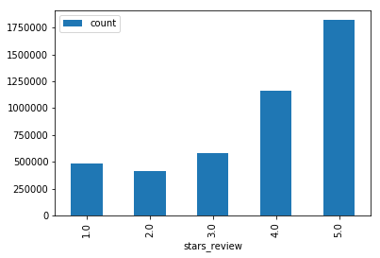
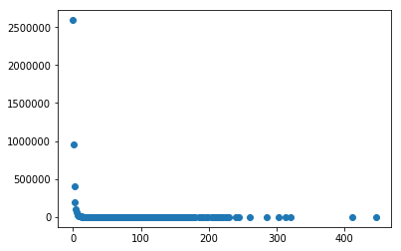
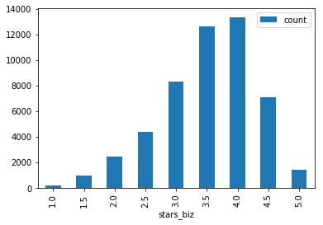
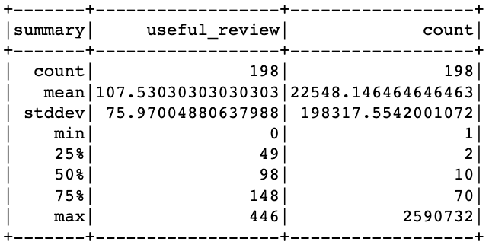
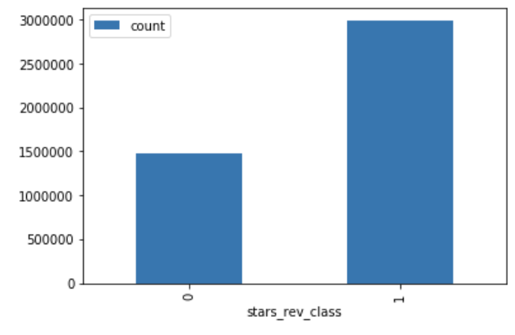
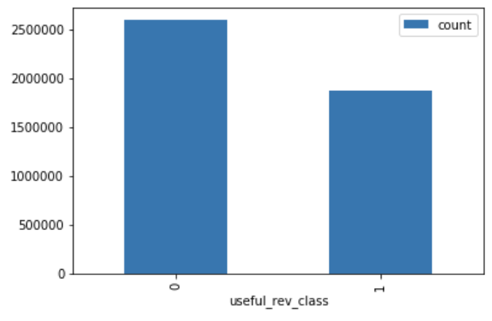
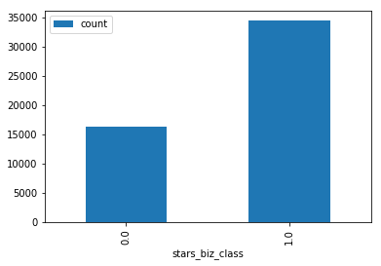
Data Preparation & Feature Engineering
Predicted Variables for Classification
Review Stars
1-3 Stars: Class 0
4-5 Stars: Class 1
Useful Reviews
0 Tag: Class 0
>=1 Tag: Class 1
Business Stars
<=3 Avg. Stars: Class 0
>3 Avg. Stars: Class 1

Slide 8
Data Preparation & Feature Engineering
Other Relevant Variables & Predictors
Variable | Type | Description | Treatment
Cool, Funny, Useful | Integer | Number of useful votes/tags received | Used as-is
Text | String | The review details, verbatim | Tokenized, vectorized using NLP
Date | String | Date in which the review is posted | Change to timestamp, used to calculate years_gap (membership duration)
Review Table
Variable | Type | Description | Treatment
Review_count | Integer | Number of reviews received | Used as-is
Categories | Array | Array of strings of business categories | Used as a filter to select “Restaurants”
State, City | String | State and city where the business resides | Used as filter
Latitude, Longitude | Float | Geo location | Used as-is
39 attributes, with nested columns | String | Nested strings of multiple attributes of the business | Unnested, counted non-nulls and sum up as new integer variable
Business Table

Slide 9
Data Preparation & Feature Engineering
Other Relevant Variables & Predictors
Variable | Type | Description | Treatment
Review_count | Integer | Number of reviews users give | Used as-is
Average_stars | Float | Average rating of all reviews given | Used as-is
Yelping_since | String | Date in which the user joined Yelp as member | Change to timestamp, used to calculate years_gap (membership duration)
Cool, Funny, Useful | Integer | Number of useful votes/tags sent by the user | Used as-is
Friends | Array | Array of strings of the user's friend as user_ids | Counted as new integer variable
Elite | Array | Array of integers, the years the user was elite | Counted as new integer variable
Fans | Integer | Number of fans the user has | Used as-is
11 compliment types columns | Integer | Number of multiple types of compliments received by user | Sum up as new integer variable
Users Table
Variable | Type | Description | Treatment
Date | String | Comma-separated list of timestamps for each check-in | Explode, change to timestamp
Checkin

Slide 10
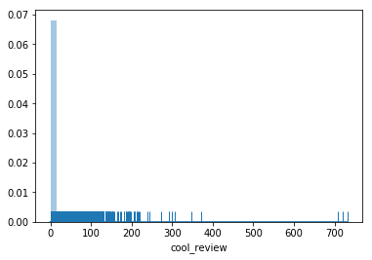
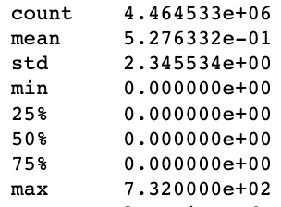
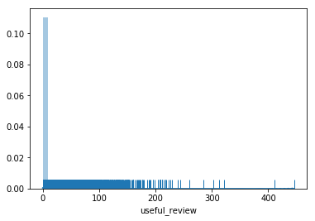
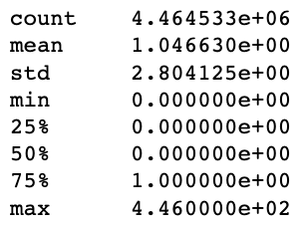

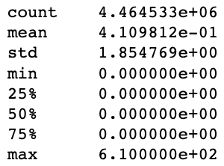
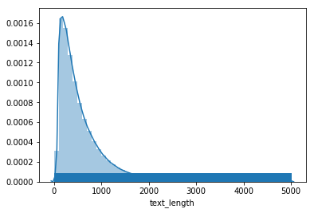
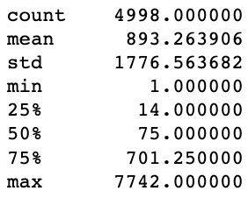
Exploratory Data Analysis (EDA)
Predictors: Distribution in Review Table

Slide 11
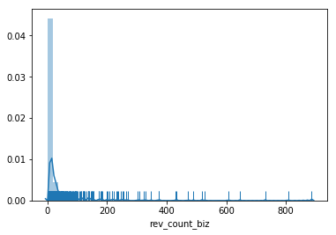
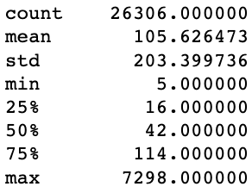
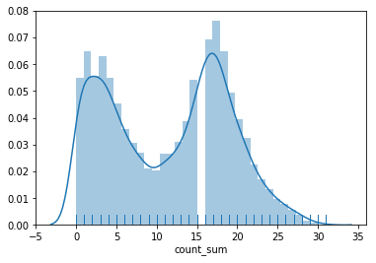
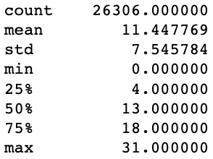
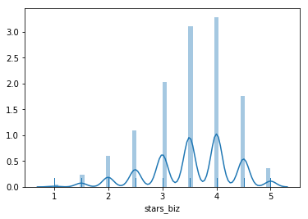
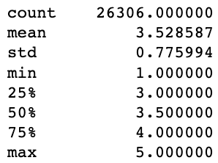
Exploratory Data Analysis (EDA)
Predictors: Distribution in Business Table

Slide 12
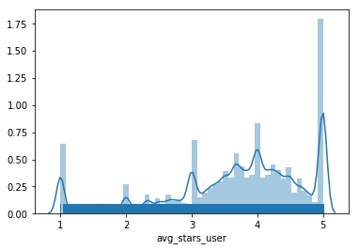
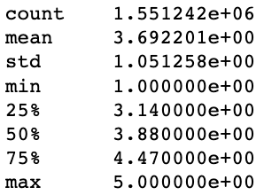
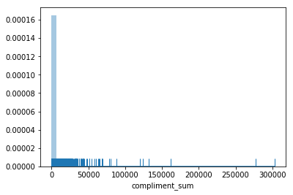
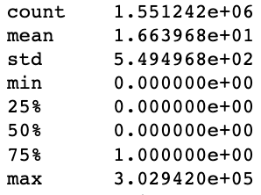
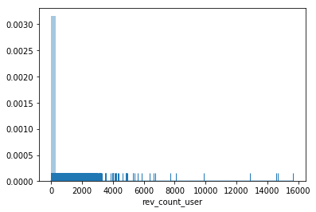
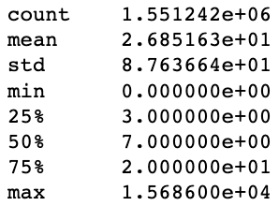
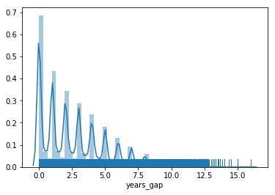
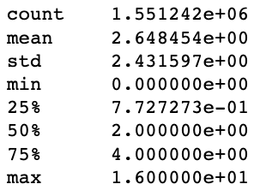
Exploratory Data Analysis (EDA)
Predictors: Distribution in Users Table

Slide 13
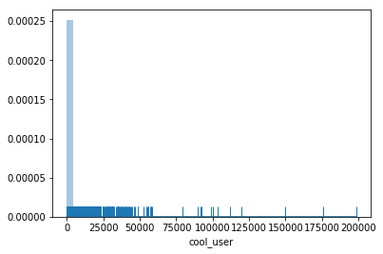
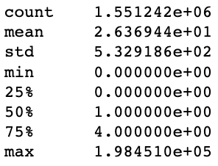
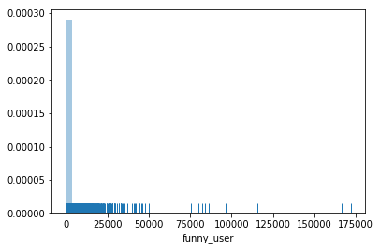
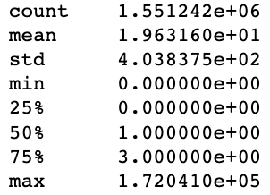
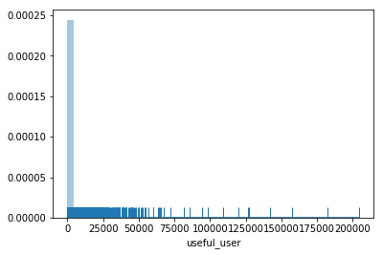
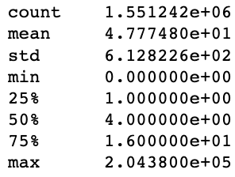
Exploratory Data Analysis (EDA)
Predictors: Distribution in Users Table

Slide 14
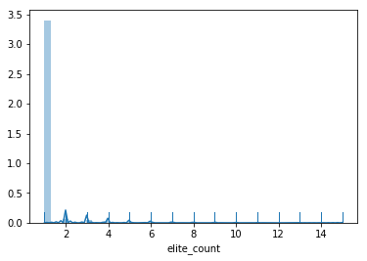
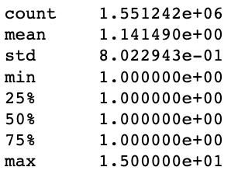
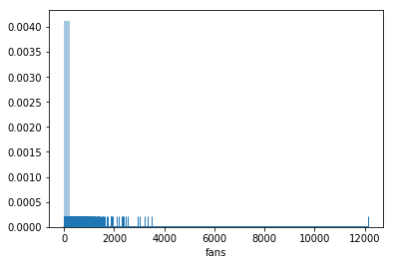
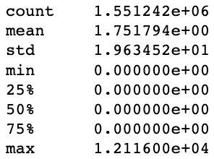
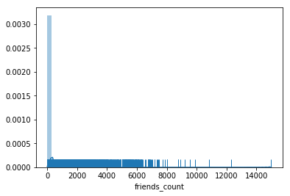
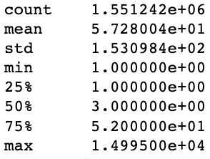
Exploratory Data Analysis (EDA)
Predictors: Distribution in Users Table

Slide 15
Exploratory Data Analysis (EDA)
Text Mining: Topic Modeling (Top2Vec)
topic: 0 | topic: 1 | topic: 2 | topic: 3 | topic: 4
good | good | good | good | good
food | food | food | food | food
great | great | great | great | great
place | place | place | place | place
go | go | go |  | go
get | get | get |  | get
realli | realli |  | realli
 | time | time |  | time
order |  | order | order
like |  | like |  | like
servic |  |  | servic
 |  |  | love | love
 |  | on |  | on
 | dog |  | delici
 | dr |  | chicken
"My husband and I come here on the regular...these hotdogs are to die for! We've introduced them to our friends and they've become regulars too. Burritos and tacos are also fantastic. Both the veggie dog and veggie taco options are top pics of mine. The chef and mastermind behind T-Locs is actually highly trained in the culinary arts so you can bet this won't be just your average food truck. Seriously, you won't be disappointed."
"Trim your dang chicken! The last two times I've been here the strips and nuggets are not trimmed or brined. You can tell because its rubbery. And they don't trim the big tendon off the pieces.....gross."

Slide 16
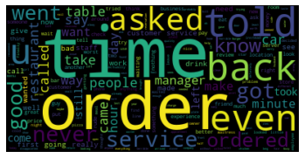
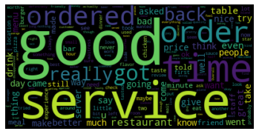
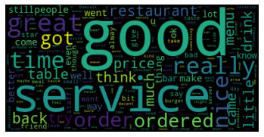
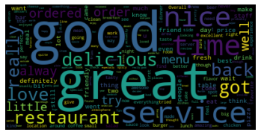
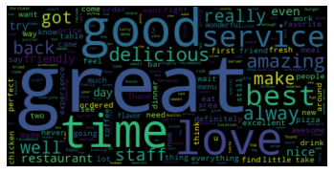
Exploratory Data Analysis (EDA)
Text Mining: Word Clouds by Review Stars

Slide 17
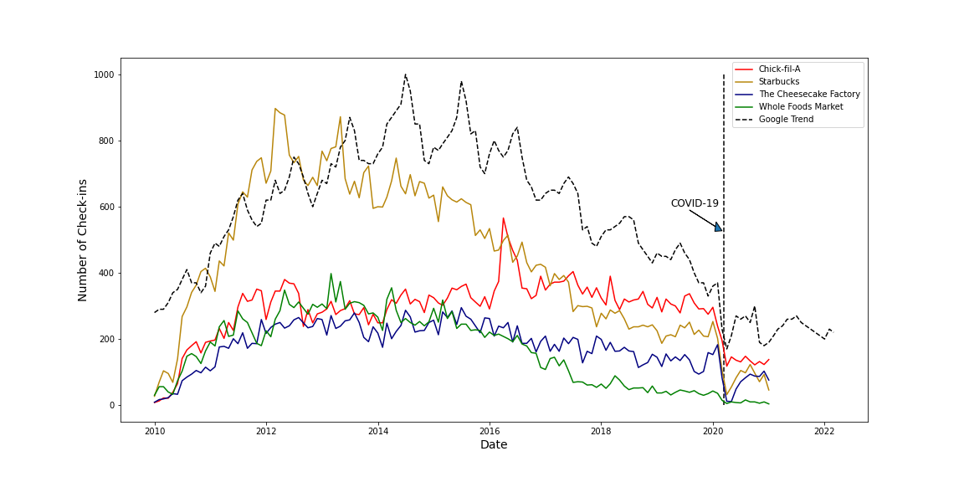
Visualization: Mapping and Timeline
Covid-19 Impacts

Slide 18
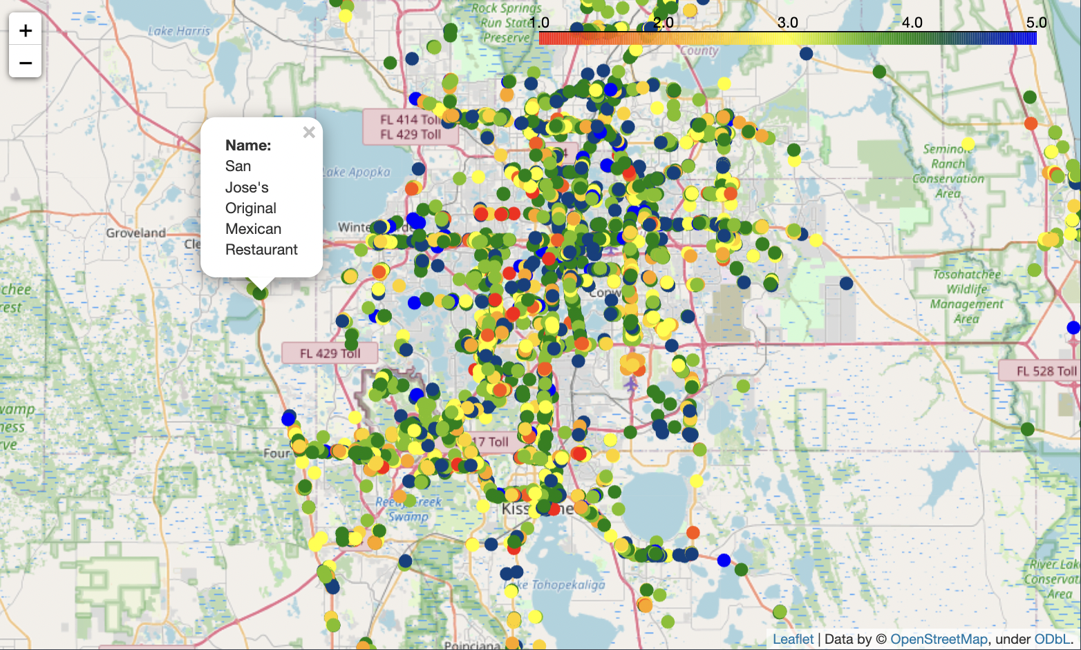
Visualization: Mapping and Timeline
Location Mapping: Finding High-Rated Restaurants

Slide 19
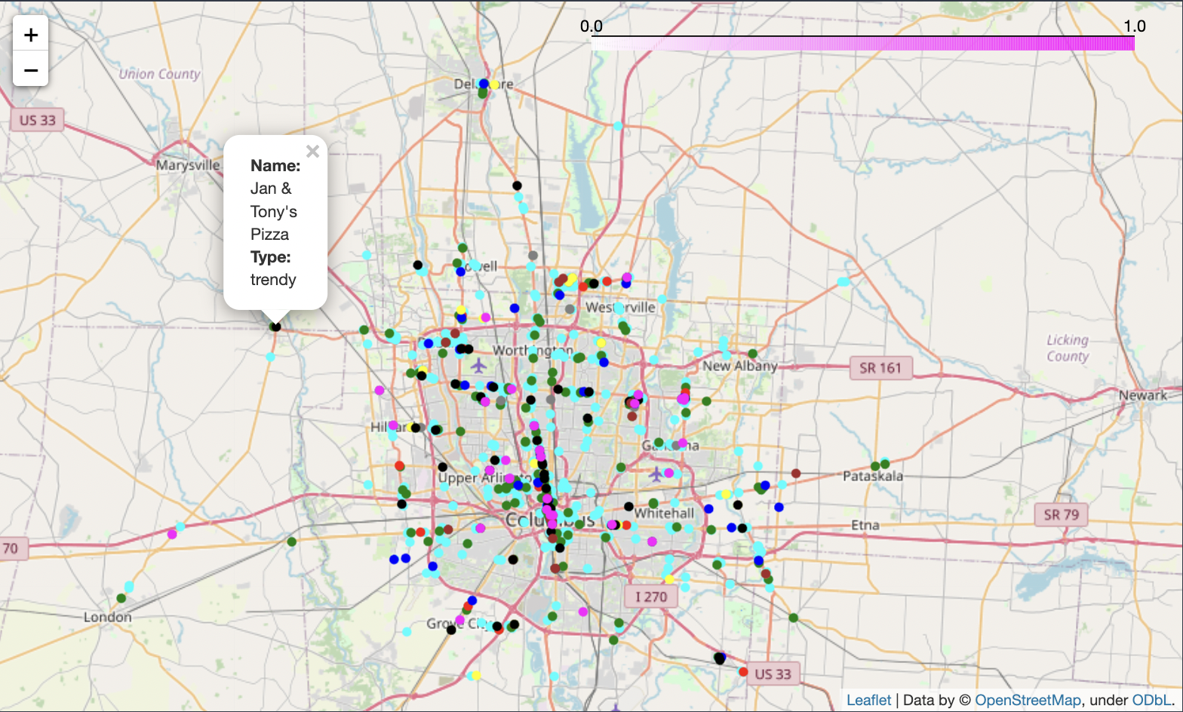
Visualization: Mapping and Timeline
Location Mapping: Restaurants by Attributes

Slide 20
Outline
1
2
BUSINESS PROBLEMS
Questions/ Use Cases
Data Sources
DATA EXPLORATION
Data Preparation
Exploratory Data Analysis
Visualizations
MODELING & EVALUATION
Recommendation System
Classification
Findings & Insights
PROJECT EXECUTION
Platforms, Tools, Methods
Challenges & Improvements
3
4

Slide 21
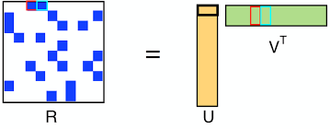


Recommendation Systems:
Collaborative Filtering
Method: Alternating Least Squares (ALS)
Recommend users based on their reviewed restaurants and ratings
RMSE = 1.54
Example Results:
Input: User #9053
Past Reviews
Recommendations

Slide 22

Recommendation Systems:
Content-Based Filtering
Method : Cosine Similarity
Text Pipeline : RegexTokenizer, StopWordsRemover, Word2Vec
Approach 1: Recommend restaurants based on keyword
Keyword: “soup”
City:
North Vancouver

Slide 23


Recommendation Systems:
Content-Based Filtering
Method : Cosine Similarity
Text Pipeline : RegexTokenizer, StopWordsRemover, Word2Vec
Approach 2: Recommend similar restaurants based restaurants’ reviews
Input:
Restaurants
Output:
Top 10
Recommendations

Slide 24



Recommendation Systems:
Content-Based Filtering
Method : Cosine Similarity
Text Pipeline : RegexTokenizer, StopWordsRemover, Word2Vec
Approach 3: Recommend similar restaurants based users given reviews
Input: Users
Output:
Top 10
Recommendations

Slide 25
Classification 1:
Review Stars
Predictors
Predicted
Table: Reviews
Review Stars
Text:
Tokenized
Stop Words Removed
Stemmed
Vectorized Count
Spark-NLP
Class 0: 1-3 Stars
Class 1: 4-5 Stars

Slide 26
Classification 1:
Review Stars
Most of the models generate high Accuracy and F1-Score, indicating that Review Text can be a good predictor of Review Stars.
Model | Accuracy | Precision | Recall | F1-Score
Logistic Regression | 81% | 72% | 73% | 72%
Decision Tree | 72% | 56% | 68% | 62%
Random Forest | 67% | 92% | 2% | 4%
Naive Bayes | 81% | 72% | 72% | 72%
Highest positive coefficients - +year
cantmiss, cor, sixpack, groggi, arw, wideei, homespun, scovil, hyperact, acceler, mono, rougher, olden, culantro, cong, twostori, kampachi, autopilot
Highest negative coefficients - audaci, sinclair, hovel, ogunquit, polaroid, antidot, ironwork, soliloqui, caf, studious, cacophoni, betterth, deform

Slide 27
Classification 2:
Useful Reviews
Predictors
Predicted
Table: Reviews
Text:
Tokenized
Stop Words Removed
Word2Vec
Useful Tag
Spark-ML
Class 0: No Tags
Funny Tags
Cool Tags
Review Stars
Table: Users
Funny Tag
Useful Tag
Cool Tag
Elite Tag
Friends
Fans
Count of compliments
Years_gap (join date to review date, include values >=0)
Class 1: >=1 Tag
Table: Business
Total Review Counts
Avg Stars
Count of Non-Null Attributes

Slide 28
Classification 2:
Useful Reviews
Model | Accuracy | Precision | Recall | F1-Score
Random Forest | 74% | 73% | 89% | 80%
Logistic Regression | 76% | 75% | 90% | 82%
Gradient Boosted Tree | 76% | 76% | 87% | 81%

Slide 29


Classification 2:
Useful Reviews
Feature Importance
Correlation to Predicted Variable

Slide 30

Classification 2:
Useful Reviews
LR Coefficients
Features
0 - funny_review,
1 - cool_review,
2 - stars_review,
3 - rev_count_biz,
4 - stars_biz,
5 - count_sum,
6 - elite_count,
7 - friends_count,
8 - years_gap,
9 - funny_user,
10 - useful_user,
11 - cool_user,
12 - compliment_sum,
13 - fans,
14 - text_length

Slide 31
Classification 3:
Business Stars
Predictors
Predicted
Table: Reviews
Table: Business
Useful Tags
Funny Tags
Cool Tags
Text Length
Total Review Counts
Count of Non-Null Attributes
Avg. Biz Stars
Class 0: <=3 Stars
Table: Users
Funny Tag
Useful Tag
Cool Tag
Elite Tag
Friends
Fans
Count of compliments
Years_gap (join date to review date, include values >=0)
Class 1: >3 Stars

Slide 32
Classification 3:
Business Stars
Model | Accuracy | Precision | Recall | F1-Score
Random Forest | 72% | 66% | 24% | 35%
Logistic Regression | 74% | 65% | 39% | 48%
Gradient Boosted Tree | 75% | 64% | 48% | 55%
Naive Bayes | 68% | 49% | 16% | 25%
Most of the models generate high accuracy
However, recall score is generally quite low, indicating relatively low sensitivity.
For example, for Gradient Boosted Tree model, correctly identified class is only 48% of the total relevant population
Low recall score drags down the F1-Score, only Gradient Boosted Tree that is able to generate >50% F1-Score

Slide 33



Classification 3:
Business Stars
Feature Importance
Correlation to Predicted Variable
LR Coeff
The more reviews are tagged as ‘cool’, the higher the stars a business will potentially receive.
The more reviews are tagged as ‘funny’ the lower the stars a business will potentially receive.
The more reviews received by the business, the more likely the business to get a high star rating.
People tend to give higher ratings in their reviews.

Slide 34
Outline
1
2
BUSINESS PROBLEMS
Questions/ Use Cases
Data Sources
DATA EXPLORATION
Data Preparation
Exploratory Data Analysis
Visualizations
MODELING & EVALUATION
Recommendation System
Classification
Findings & Insights
PROJECT EXECUTION
Platforms, Tools, Methods
Challenges & Improvements
3
4

Slide 35




Platforms, Tools, Methods
Challenges:
GCP - Free Account Limitations
Server Down, Timeout
Limited Clusters Availability
Limited Capacity
Approaches:
Repartition
Test on Small Samples
Incremental Increase

Slide 36
Challenges & Improvements
Training Dataset in Batches
In order to overcome limited capacity in data processing, while also improving the model
Platform Backups
Use more than one platform as a backup
Parallel Platform Testing
When possible, try to process/run the model/dataset in multiple platforms at the same time to evaluate the performance
Samplings
Increase the sample size, starting from a very small set of data
Fine Tuning Hyperparameters & Test Other Models
Hybrid methods for Recommendation System
Grid search optimization
Automation of the Pipeline
Use Airflow to automate tasks such as data extraction, feature engineering, modeling and prediction
In-Depth Text-Mining Exploration
Further examination on text variables and context based on initial findings from the modeling

